Slide 1
Autodock Vina through Chimera
By Dallas Lee
Adapted from José R. Valverde, licensed under CC BY-NC-SA 3.0

Slide 2
Autodock Vina
http://vina.scripps.edu
For Mac: Download .tgz
Place vina and vina_split executable files in your path (/usr/local/bin)

Slide 3
UCSF Chimera
https://www.cgl.ucsf.edu/chimera/
Download the current production release .dmg
Place the Chimera.app in your Applications folder

Slide 4
Open Babel/ iBabel
Minimize energy conformation of ligand
Automatically uses MMFF94
Cmake ~/openbabel-2.4.1 -DBUILD_GUI=ON
Obgui

Slide 5
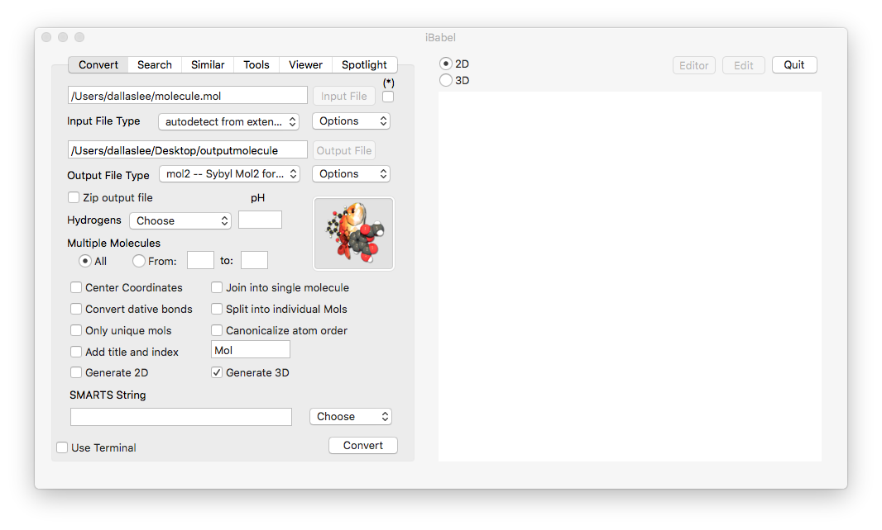
iBabel
GUI interface for Open Babel file converter
Requires either Conda or Homebrew to install Open Babel
Convert drawn ligands and molecular structures interchangeably, e.g. Chemdraw, PDB, Gaussian, GAMESS, GROMACS, etc*.
*Add hydrogens when drawing

Slide 6
Loading the receptor
Open UCSF Chimera and then load the protein:
For your own files: File → Open ‘Yourdocuments/epsilon-zeta/XYZ1.pdb’
For PDB structures: Fetch →PDB number

Slide 7
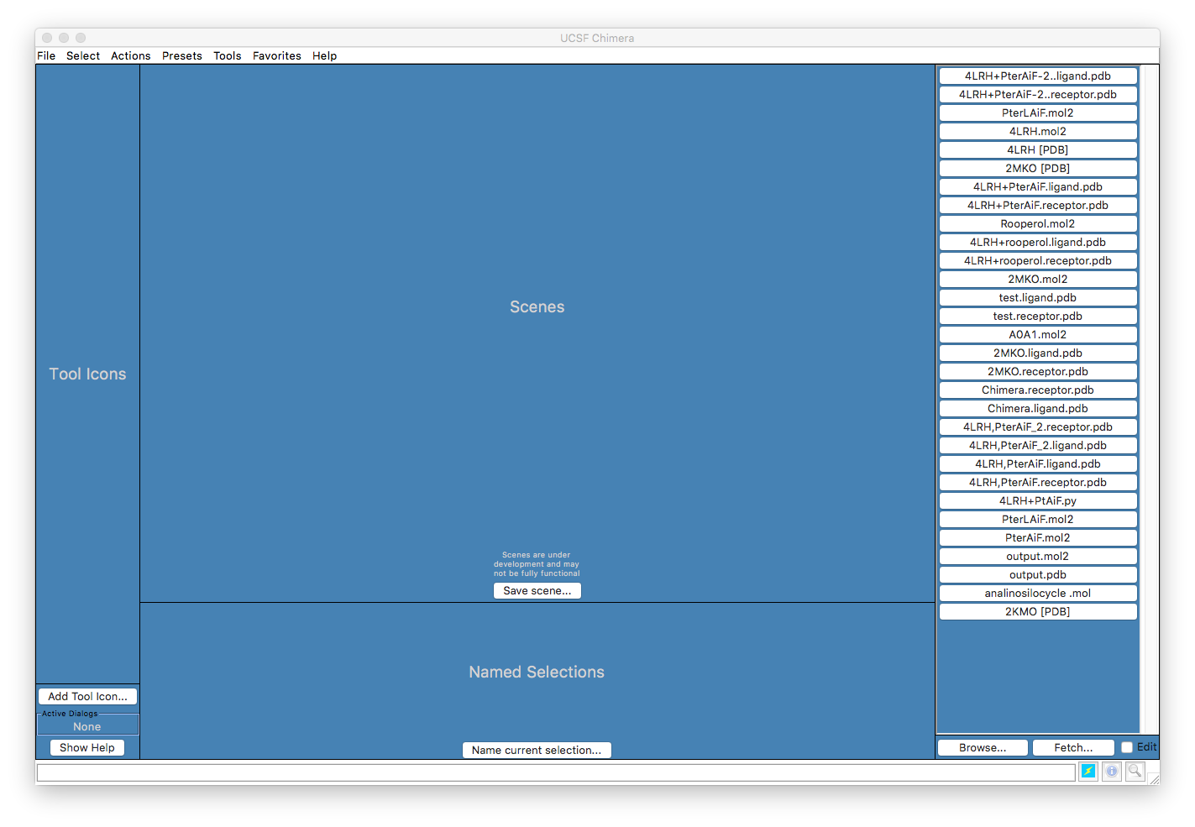

Slide 8
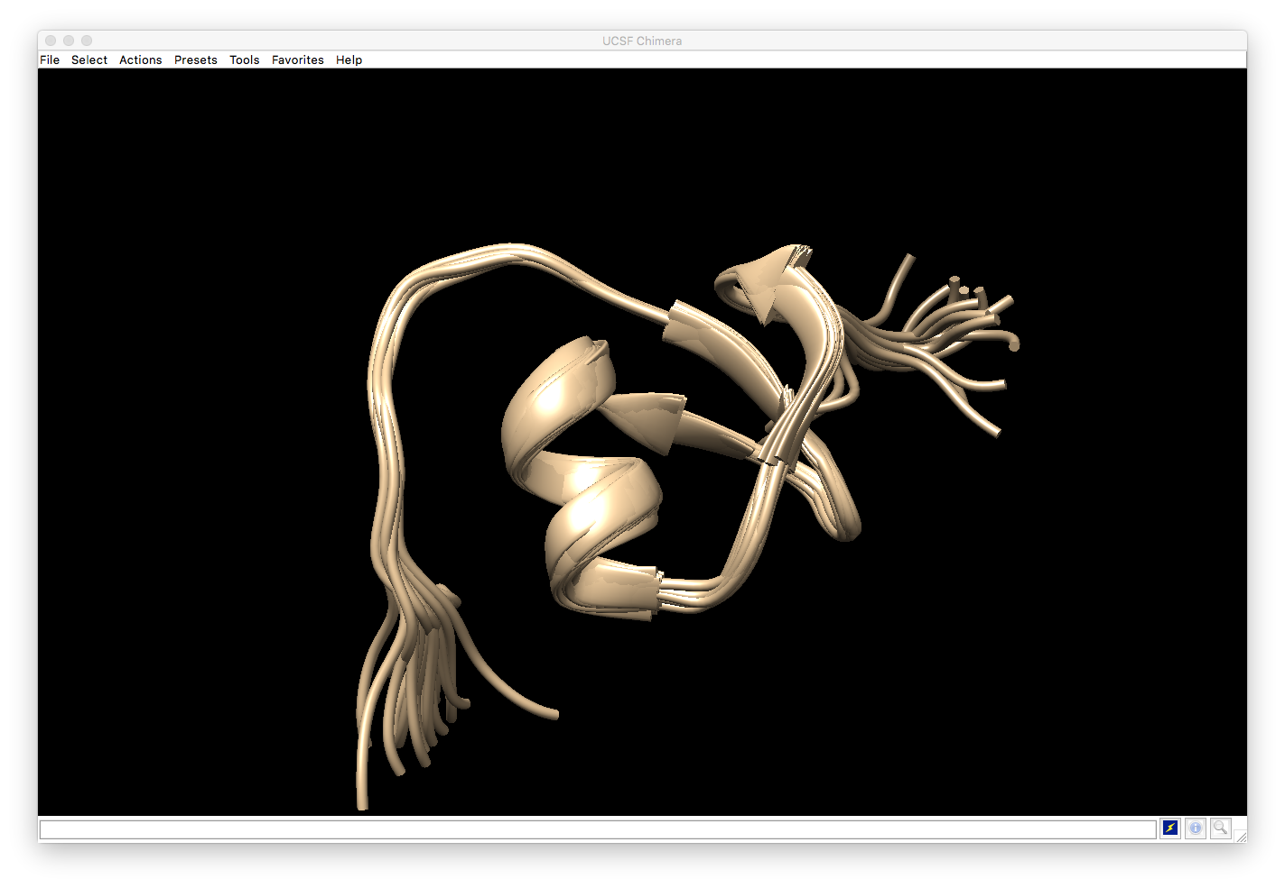

Slide 9
Preparing the receptor
Tools → Surface/Binding Analysis → DockPrep
Select conformation
Click →OK

Slide 10
Adding Hydrogens
you can specify the protonation state for specific residues if needed

Slide 11
Assigning charges
Protein charges are assigned using an AMBER forcefield
AMBER does not contain charges for most non­ protein atoms:
AM1­BCC (semi­empirical quantum mechanics, accurate but slow)
Gasteiger (empirical rules, fast)

Slide 12
Specify Net Charges
For non­protein molecules in the model (if included)
Specify expected net charge of the whole molecules
Specify how to compute the charges for each atom in the molecules, e.g. potassium ion, K+, assign a charge of +1.
Generally (for protein residues and non­protein molecules) Chimera will check that the sum of atomic charges leads to an integer matching the expected summary charge.

Slide 13
Save results
Save the “clean” receptor as a “MOL2” file

Slide 14
Open the ligand
File → Open → outputmolecule.mol2
Make sure the input molecule contains all hydrogens

Slide 15
Prepare the docking job
Tools → Surface/Binding Analysis → AutoDock Vina

Slide 20
Displaying Hydrogen Bonds
Hbonds->Add count to entire receptor
Find inter-model bonds
Color H-bonds differently
If endpoint is hidden…

Slide 21
Viewing Docked Ligands
Bring up the “Model Panel”
Tools → Model Panel
You can activate/deactivate which models are shown
Play with selections to show only relevant information
Select the reference ligand and give it a special color
In the View Dock window Movie->Play to show all the docked conformations
Play with UCSF Chimera...

